Slide 1

EEE 324: Digital Signal Processing
Dr. Khurram Ali
Assistant Professor
Department of Electrical & Computer Engineering, COMSATS University Islamabad, Lahore Campus

Slide 2


Week 8: Frequency Analysis
❑ Frequency Analysis of continuous time periodic signals
❑ Frequency Analysis of continuous time aperiodic signals
❑ Frequency Analysis of discrete time periodic signals
❑ Frequency Analysis of discrete time aperiodic signals

Slide 3




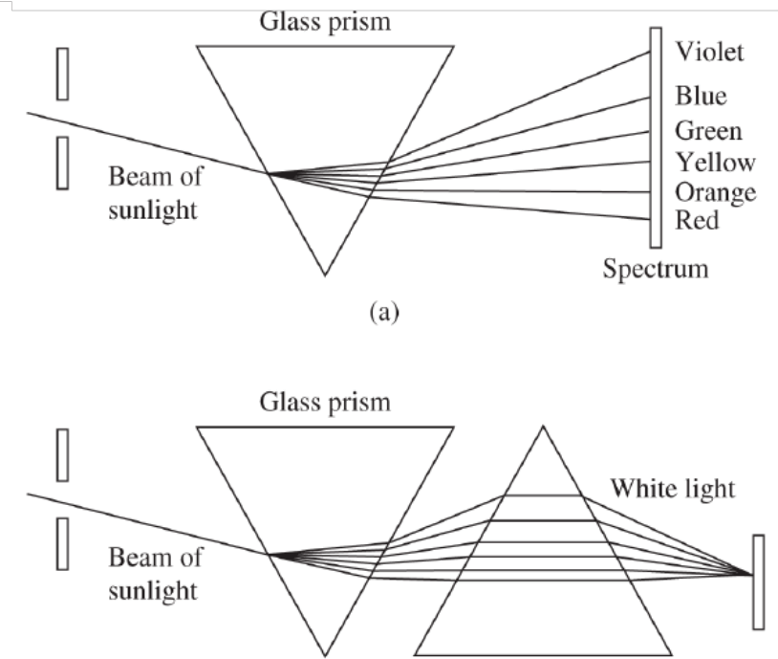
Frequency Analysis
Decompose light into different colors.
Combine all the colors to synthesize the light again
= Proper Mathematical tool

Slide 4




Frequency Analysis
Decompose light into different colors.
Combine all the colors to synthesize the light again
= Proper Mathematical tool
Time Domain Signal
Frequency (sinusoidal) components of signal
Fourier Analysis
CT signal
DT signal
Magnitude of frequency components
Phase of frequency components
Periodic
Aperiodic
Fourier Series
Fourier Transform
Periodic
Aperiodic

Slide 5



Frequency Analysis
Frequency Analysis
Fourier synthesis
Fourier analysis
Signal analysis
Signal synthesis
Decompose time domain signal into its constituent frequency components using direct Fourier series/transforms
Combine all the constituent frequency components of the signal using inverse Fourier series/transforms, to synthesize the original time domain signal

Slide 6
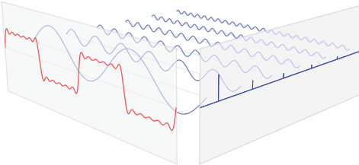
Frequency Analysis
Constituent frequency components
Frequency domain representation
Time domain signal

Slide 7




Week 8: Frequency Analysis
❑ Frequency Analysis of continuous time periodic signals
❑
❑
❑

Slide 8


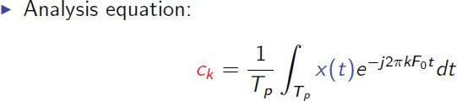
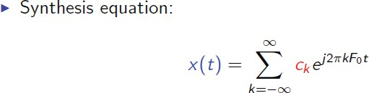
Continuous time Fourier series

Slide 9

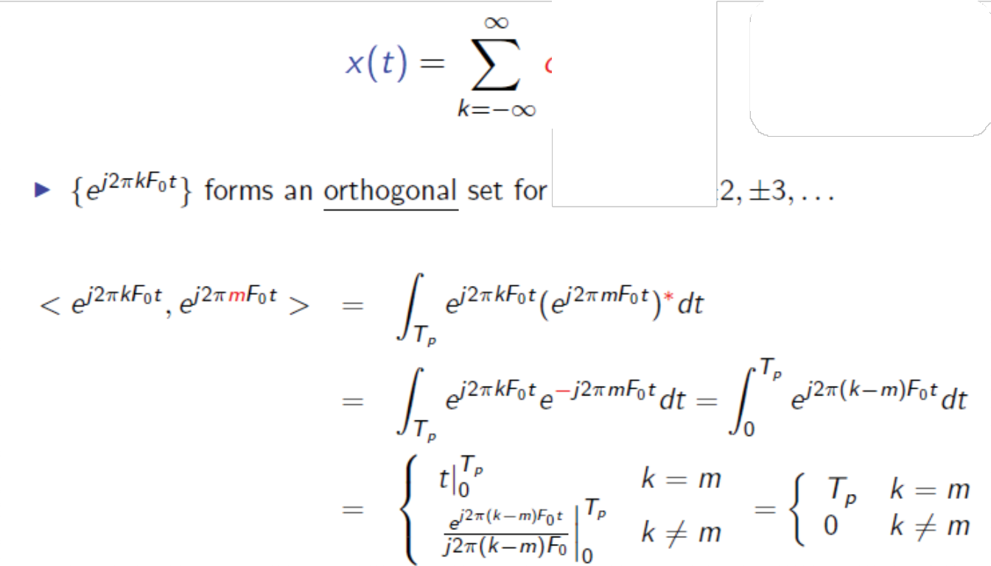




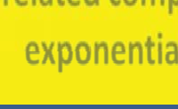


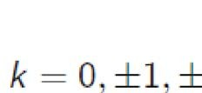
Continuous time Fourier series
CTFS Intuition
CT Harmonically related complex exponentials
Dot Product between any two different signals in the set is ZERO !

Slide 10
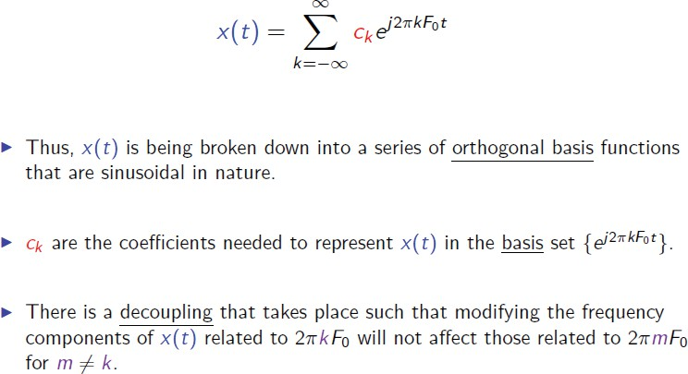
Continuous time Fourier series
CTFS Intuition

Slide 11

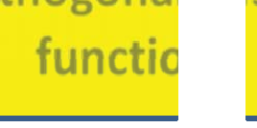

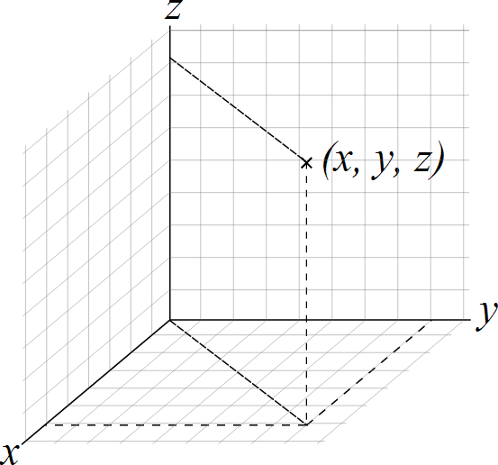

















Continuous time Fourier series
Orthogonal basis function
CTFS Intuition
3D-Cartesian coordinate system (x, y, z) forms 3D orthogonal basis.
Any vector in 3D can be expressed in terms of (x, y, z)

Slide 12





Continuous time Fourier series
Orthogonal basis function
CTFS Intuition
Similarly,
_{e} j 2πkF_{o}t
forms infinite-Dimension orthogonal basis. Any
signal can be expressed in terms of this set.

Slide 13
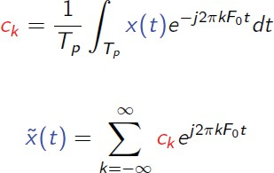





Continuous time Fourier series
CTFS:
Dirichlet Conditions
Will x(t) be equal to its Fourier series representation at every value of t?

Slide 14




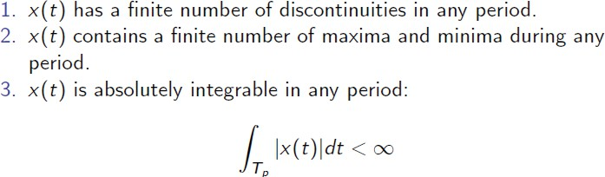
Continuous time Fourier series
CTFS: Dirichlet Conditions
x(t) will be equal to its Fourier series representation at every value of t iff:

Slide 15
Continuous time Fourier series
CTFS:
Dirichlet Conditions

Slide 16
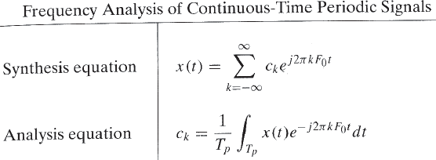

Continuous time Fourier series
CTFS: Summary
If x(t) is periodic and satisfies Dirichlet conditions:
Complex Fourier coefficients = c_{k} = c_{k} e
jθ
k
For real x(t), c* = c
k
− k

Slide 17
Continuous time Fourier series
CTFS: Representation
_{e} jθ_{k}
Complex Fourier coefficients = c_{k} = c_{k}
Magnitude Spectra
Plot of as a function of frequency
c_{k}
Phase Spectra
Plot of as a function of frequency
θ_{k}

Slide 18

Continuous time Fourier series
CTFS: Representation
_{e} jθ_{k}
Complex Fourier coefficients = c_{k} = c_{k}
Power Spectra
Plot of as a function of frequency
P_{X} = c_{k}
2
Remember! Periodic signals are power signals i.e. have infinite energy and finite power. Power of signal can be computed either in time domain or in frequency domain. Parseval’s Theorem:

Slide 19
Continuous time Fourier series
CTFS: Representation
_{e} jθ_{k}
Complex Fourier coefficients = c_{k} = c_{k}
Magnitude Spectra
Line Spectra or Discrete Spectra
Phase Spectra
Power Spectra

Slide 20
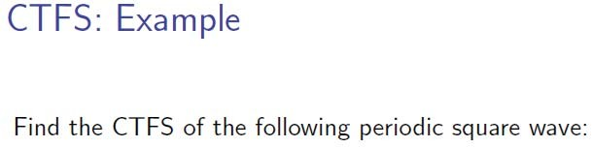
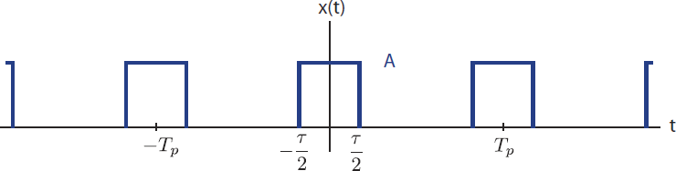
Continuous time Fourier series

Slide 21


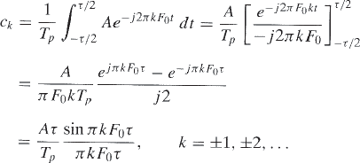
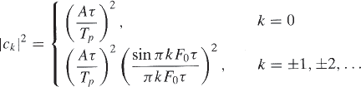
Continuous time Fourier series

Slide 22
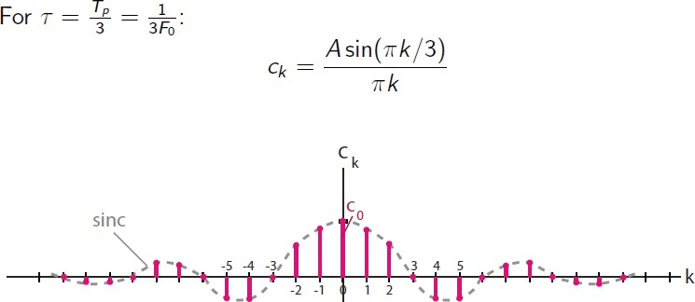
Continuous time Fourier series

Slide 23
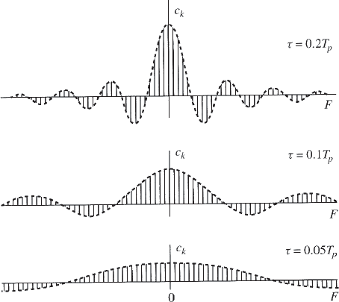
Continuous time Fourier series
A lot of insight about signal
Fix T_{p} vary τ
Frequency contents of signal are same but the power distribution among different frequencies changes

Slide 24
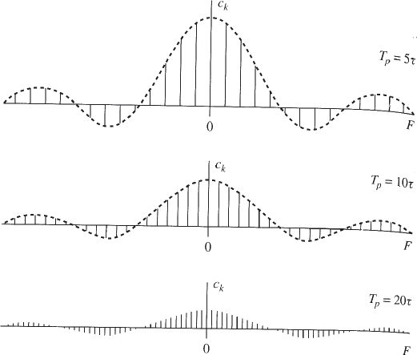
Continuous time Fourier series
A lot of insight about signal
Vary T_{p} fix τ
Frequency contents of signal are changed

Slide 25
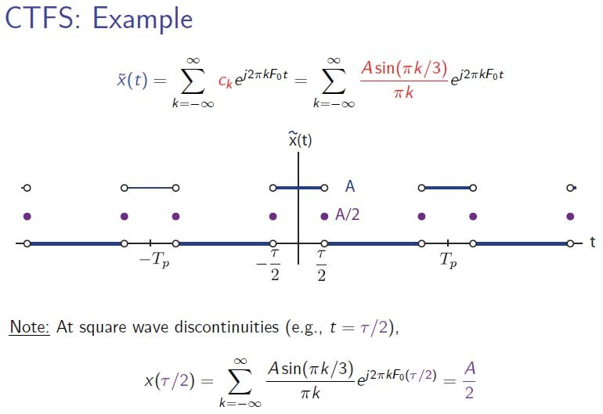
Continuous time Fourier series
Discontinuity at τ / 2

Slide 26
Week 8: Frequency Analysis
❑
❑ Frequency Analysis of continuous time aperiodic signals
❑
❑

Slide 27


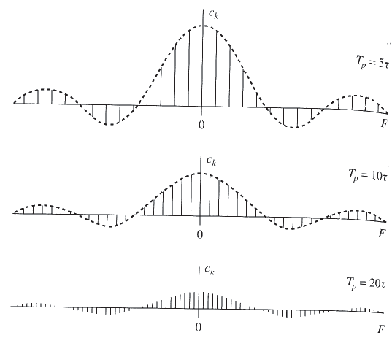
Continuous time Fourier Transform
Increase T_{p} fix τ
Lines come closer to each other. Envelope remains same.
T_{p} → ∞
Spectrum becomes continuous
x(t) is no more periodic

Slide 28

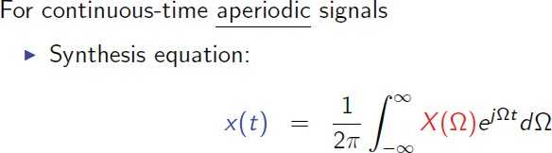

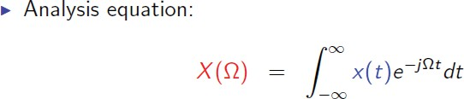

Continuous time Fourier Transform

Slide 29
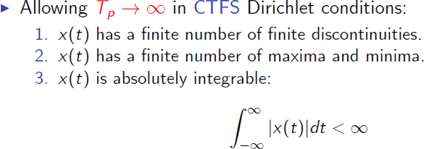
Continuous time Fourier Transform
CTFT:
Dirichlet Conditions

Slide 30
Continuous time Fourier Transform
CTFT:
Representation
X ( F ) = X ( F ) e ^{jΘ(F )}
Magnitude Spectrum
Plot of as a function of frequency
X ( F )
Phase Spectrum
Plot of Θ( F ) as a function of frequency

Slide 31

Continuous time Fourier Transform
CTFT:
Representation
X ( F ) = X ( F ) e ^{jΘ(F )}
Energy Spectrum
Plot of as a function of frequency
S_{XX} ( F ) = X ( F )
2
Remember! aperiodic signals are energy signals i.e. have finite energy and zero power. Energy of signal can be computed either in time domain or in frequency domain. Parseval’s Theorem:

Slide 32
Continuous time Fourier series
CTFT: Representation
CT Fourier Transform = X ( F ) = X ( F ) e ^{jΘ(F )}
Magnitude Spectrum
Continuous Spectrum
=
Envelope of corresponding periodic signal’s spectra
Phase Spectrum
Energy Spectrum

Slide 33
Continuous time Fourier Transform
CTFT:
Representation
If x(t) is real
X ( F ) = X ( F ) e ^{jΘ(F )}
X (−F ) = X ( F )
Θ(−F ) = −Θ( F ) S_{XX} (−F ) = S_{XX} ( F )

Slide 34


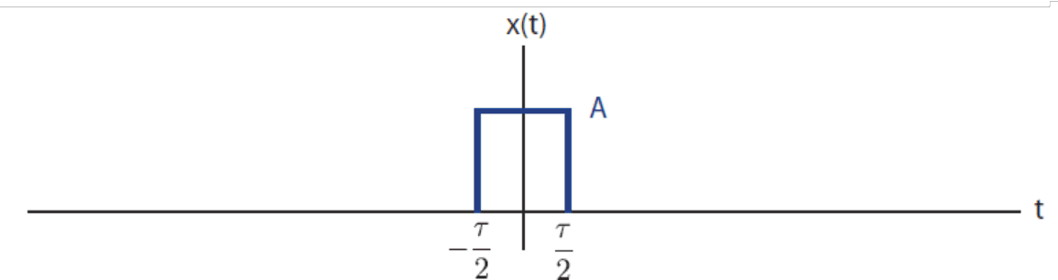



Continuous time Fourier Transform
Spectrum of rectangular pulse is the envelope of the line spectrum (CTFS coefficients) of the periodic signal obtained by periodically repeating the pulse with period Tp.

Slide 35
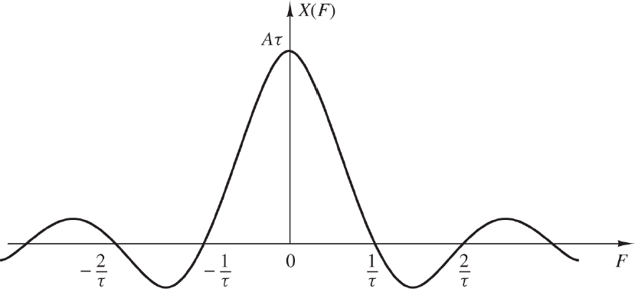
Continuous time Fourier Transform
Zero crossing at multiples of 1/tau.
Width of main lobe = 2/tau.
As pulse duration i.e. tau increases or decreases, the main lobe becomes more narrower or wider, and we say that more energy is moved to lower or higher frequencies respectively.

Slide 36
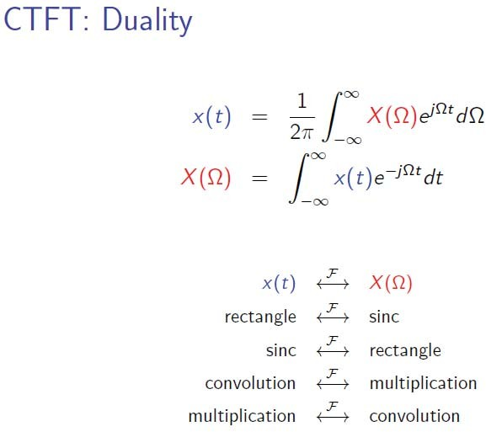
Continuous time Fourier Transform

Slide 37
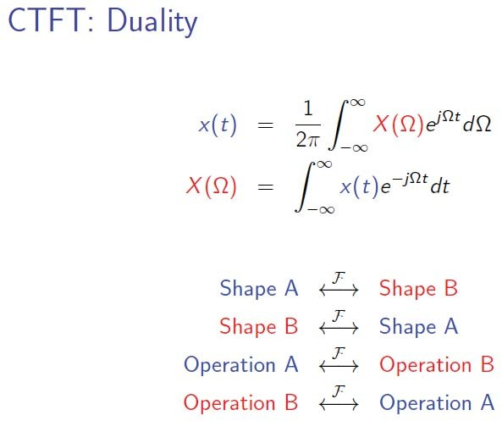
Continuous time Fourier Transform

Slide 38
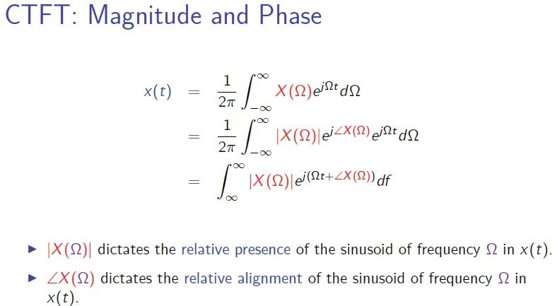
Continuous time Fourier Transform

Slide 39
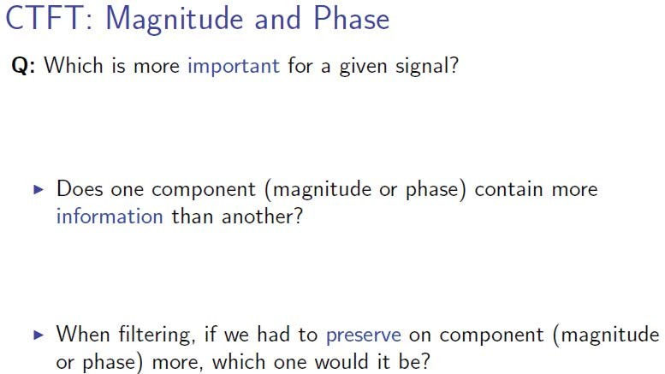
Continuous time Fourier Transform

Slide 40
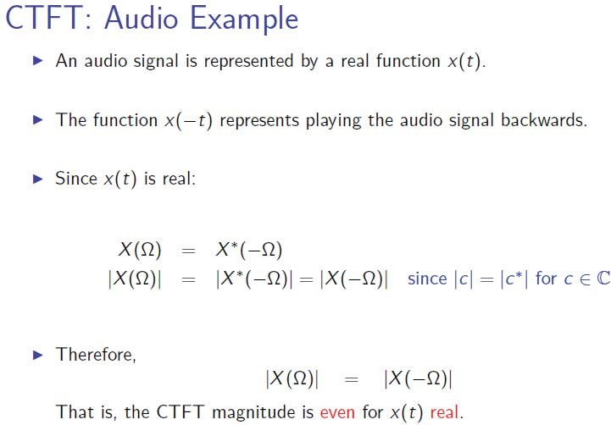
Continuous time Fourier Transform

Slide 41
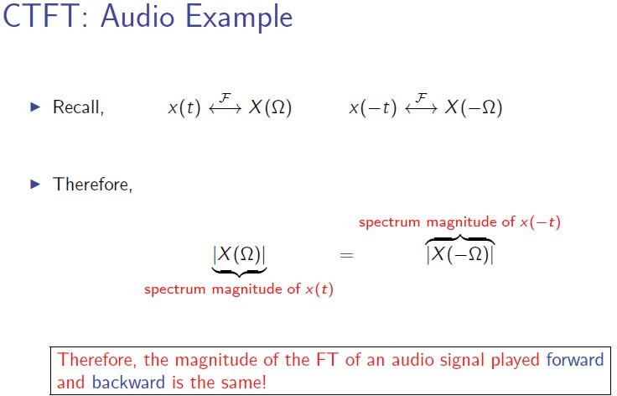
Continuous time Fourier Transform

Slide 42
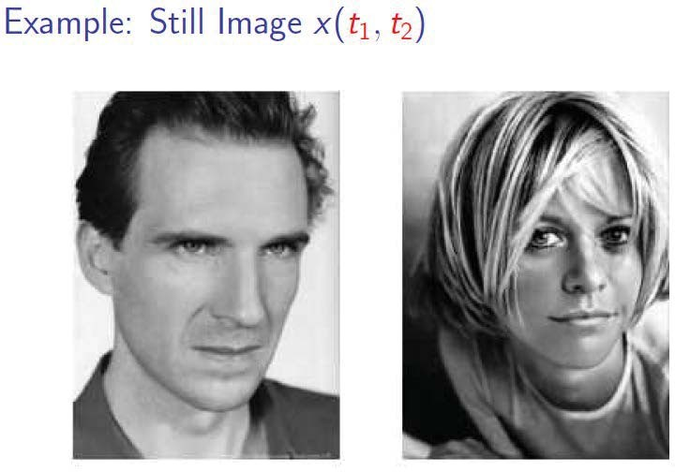
Continuous time Fourier Transform

Slide 43
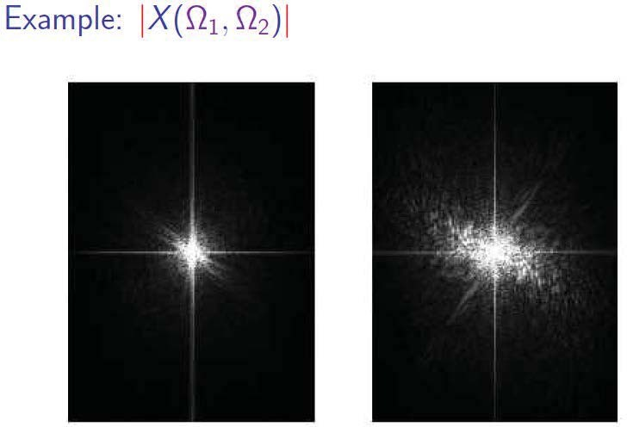
Continuous time Fourier Transform

Slide 44
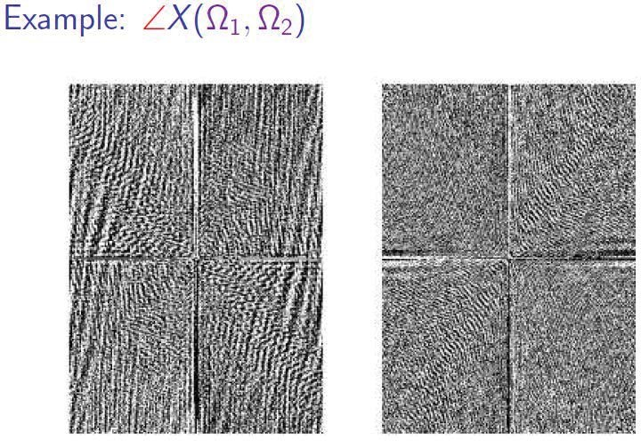
Continuous time Fourier Transform

Slide 45
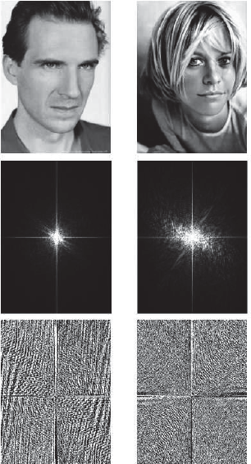
Continuous time Fourier Transform

Slide 46
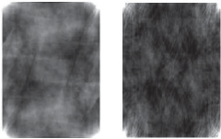

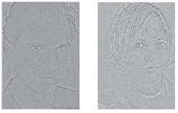

Continuous time Fourier Transform

Slide 47
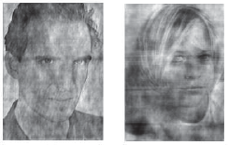
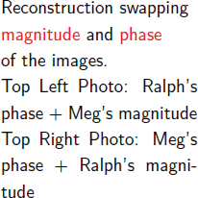
Continuous time Fourier Transform

Slide 48
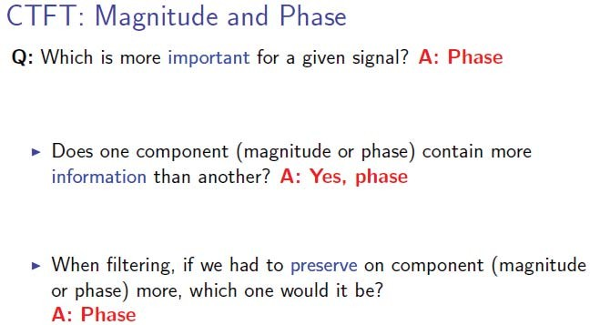
Continuous time Fourier Transform

Slide 49
Week 8: Frequency Analysis
❑
❑
❑ Frequency Analysis of discrete time periodic signals
❑

Slide 50


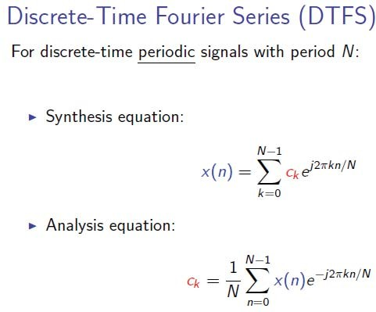
Discrete time Fourier Series

Slide 51


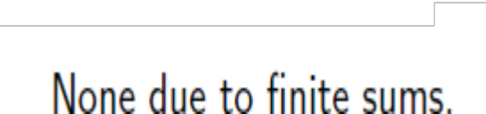

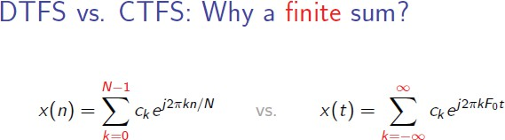
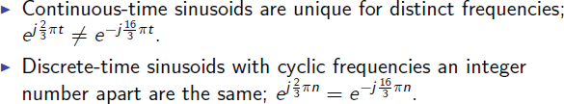
Discrete time Fourier Series

Slide 52
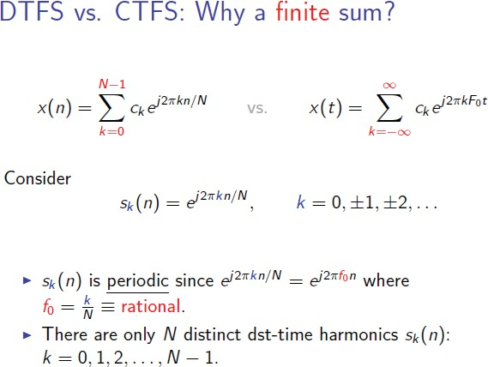
Discrete time Fourier Series

Slide 53

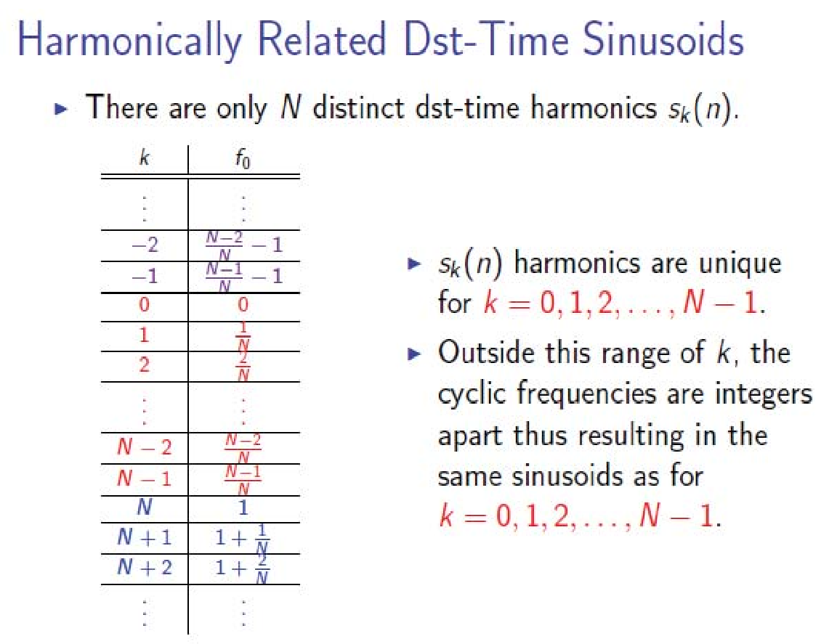
Discrete time Fourier Series

Slide 54

Discrete time Fourier Series
So, only N distinct Fourier coefficients i.e. for k=0,1,2, … , N-1. This range covers the fundamental frequency range i.e. f goes from 0 to 1. Outside this range, Fourier coefficients are periodic:
Spectrum of a periodic discrete time signal with period N is also periodic with period N

Slide 55
Continuous time Fourier series
DTFS: Representation
_{e} jθ_{k}
Complex Fourier coefficients =
c = c
k k
k = 0,1, 2,..., N −1
Magnitude Spectrum
Plot of as a function of frequency
c_{k}
Phase Spectrum
Plot of as a function of frequency
θ_{k}

Slide 56

Continuous time Fourier series
DTFS: Representation
_{e} jθ_{k}
Complex Fourier coefficients =
c = c
k k
k = 0,1, 2,..., N −1
Power Spectrum
Plot of as a function of frequency
P_{X} = c_{k}
2
Remember! Periodic signals are power signals i.e. have infinite energy and finite power. Power of signal can be computed either in time domain or in frequency domain. Parseval’s Theorem:

Slide 57
Continuous time Fourier series
DTFS: Representation
_{e} jθ_{k}
Complex Fourier coefficients =
c = c
k k
k = 0,1, 2,..., N −1
Magnitude Spectrum
Line Periodic Spectrum or Discrete Periodic Spectrum
Phase Spectrum
Power Spectrum

Slide 58

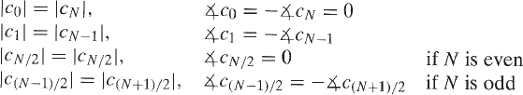
Continuous time Fourier Transform
DTFS:
Representation
If x(n) is real
Symmetry property:
From periodicity property:
For real x(n), only N/2 Fourier coefficients completely specify its spectrum. Rest can be calculated from these N/2 coefficients
From both:

Slide 59

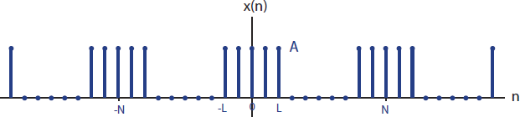

Discrete time Fourier Series

Slide 60

Discrete time Fourier Series

Slide 61
Week 8: Frequency Analysis
❑
❑
❑
❑ Frequency Analysis of discrete time aperiodic signals

Slide 62




Discrete time Fourier Transform

Slide 63



Discrete time Fourier Transform
DTFT vs. CTFT
∑ vs.
Ω is aperiodic while ω is periodic
∫

Slide 64
Continuous time Fourier Transform
DTFT:
Representation
X (ω ) = X (ω ) e ^{jΘ(ω )}
Magnitude Spectrum
Plot of as a function of frequency
X (ω )
Phase Spectrum
Plot of Θ(ω ) as a function of frequency

Slide 65

Continuous time Fourier Transform
DTFT:
Representation
X (ω ) = X (ω ) e ^{jΘ(ω )}
Energy Spectrum
Plot of as a function of frequency
S_{XX} (ω ) = X (ω )
2
Remember! aperiodic signals are energy signals i.e. have finite energy and zero power. Energy of signal can be computed either in time domain or in frequency domain. Parseval’s Theorem:

Slide 66
Continuous time Fourier series
DTFT: Representation
DT Fourier Transform =
X (ω ) = X (ω ) e ^{jΘ(ω )}
Magnitude Spectrum
Continuous Spectrum but periodic
=
Envelope of corresponding periodic DT signal’s spectra
Phase Spectrum
Energy Spectrum

Slide 67
Continuous time Fourier Transform
DTFT: Representation
If x(n) is real
X (ω ) = X (ω ) e ^{jΘ(ω )}
For real x(n), fundamental frequency range is further reduced to:
Cyclic frequency i.e. f goes from 0 to Fs/2 or
Radian frequency i.e. Small omega goes from 0 to pi
X (−ω ) = X (ω )
Θ(−ω ) = −Θ(ω )
S_{XX} (−ω ) = S_{XX} (ω )

Slide 68

Discrete time Fourier Transform

Slide 69

Discrete time Fourier Transform

Slide 70

Discrete time Fourier Transform

Slide 71

Frequency Analysis

Slide 72

Discrete time Fourier Transform

Slide 73

Discrete time Fourier Transform

Slide 74


Relationship of DTFT to the Z- Transform

Slide 75

Relationship of DTFT to the Z- Transform

Slide 76

Frequency-Domain classification of Signals: Bandwidth

Slide 77

Frequency-Domain classification of Signals: Bandwidth

Slide 78


Slide 79

Frequency-Domain and Time-Domain Signal Properties

Slide 80


Slide 81


Slide 82


Important DTFT Properties
Symmetry

Slide 83
Important DTFT Properties
Periodicity

Slide 84

Important DTFT Properties
Linearity

Slide 85

Important DTFT Properties
Time Shift

Slide 86

Important DTFT Properties
Frequency Shift

Slide 87

Important DTFT Properties
Frequency Shift

Slide 88

Important DTFT Properties
Convolution

Slide 89

Important DTFT Properties
Convolution

Slide 90

Important DTFT Properties
Modulation

Slide 91




Important DTFT Properties
Modulation

Slide 92
End

